Slide 1



Zomato Dashboard
View in Power BI
Last data refresh:
12/5/2022 3:58:22 PM UTC
Downloaded at:
3/4/2023 7:15:42 PM UTC

Slide 2
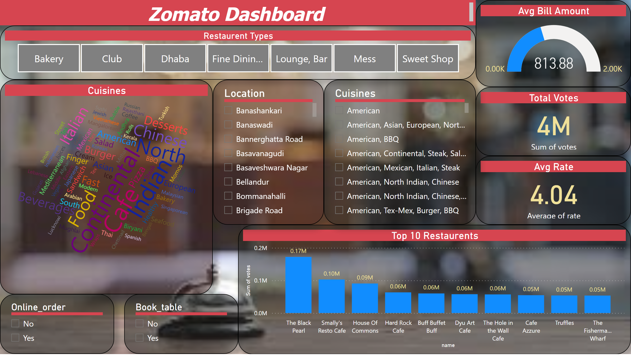
Page 1
Notes:
textbox
No alt text provided
slicer
No alt text provided
slicer
No alt text provided
Cuisines
No alt text provided
slicer
No alt text provided
slicer
No alt text provided
Avg Bill Amount
No alt text provided
Restaurent Types
No alt text provided
Top 10 Restaurents
No alt text provided
Avg Rate
No alt text provided
Total Votes
No alt text provided

